Slide 1
Voting System in C++ Programming
A Simple Implementation for Vote Counting
Presented By: UBAID ULLAH

Slide 2
Introduction to Voting Systems
What is a Voting System?
A voting system allows people to choose a candidate or a choice from a list of options.
The results are tallied and the candidate or choice with the highest votes wins.
Purpose of the Project:
Simulate a basic election process using a C++ program.
Handle multiple candidates, allow voters to cast votes, and tally the results.

Slide 3
Key Features of the Voting System
Candidates List: Users can define the list of candidates.
Voter Participation: Multiple voters can cast votes.
Vote Validation: Ensures votes are valid and within the allowed candidate range.
Vote Counting: Tally votes for each candidate and determine the winner.
Display Results: Show the winner and their total vote count

Slide 4
Key Concepts in C++ Used
Arrays:
Used to store the names of candidates and the number of votes.
For Loop:
To collect votes from voters.
Conditional Statements:
To check for valid votes and handle invalid inputs.
Data Input/Output:
Using cin to get user input and cout to display results.

Slide 5
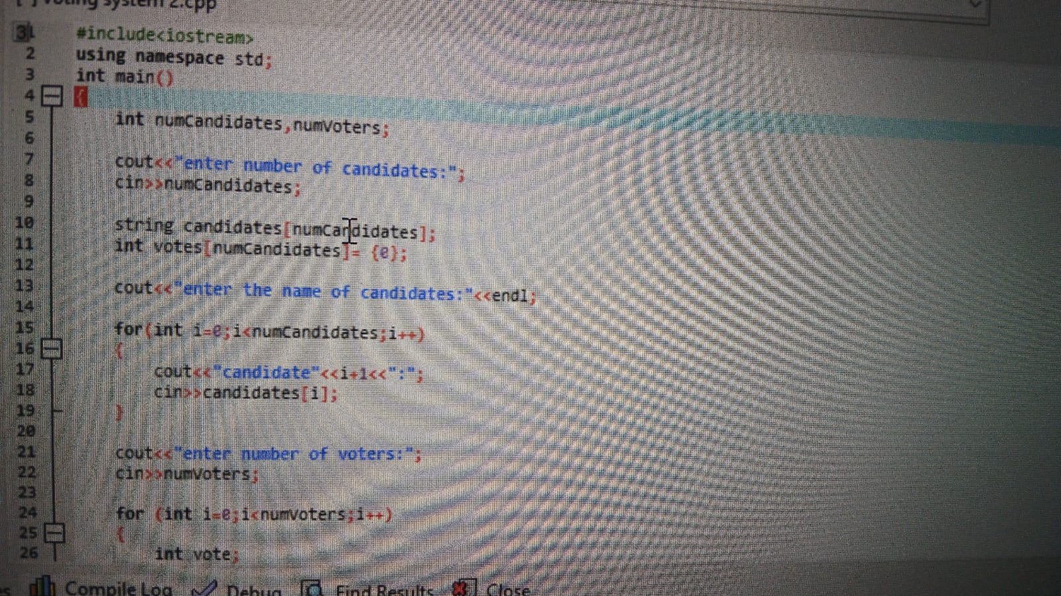
C++ Code Breakdown

Slide 6
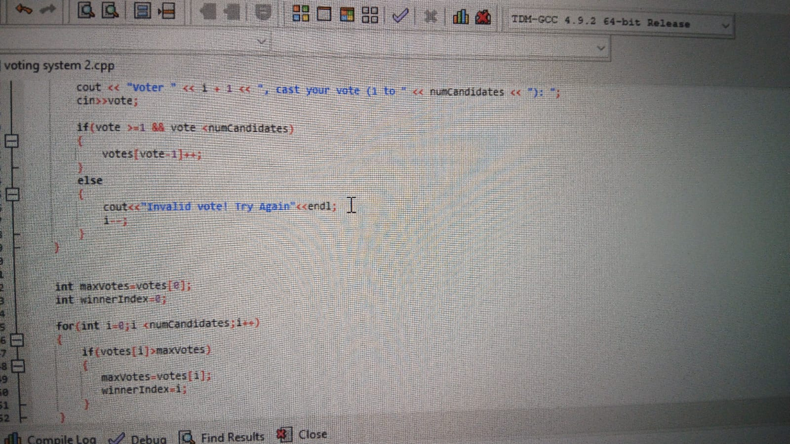

Slide 7
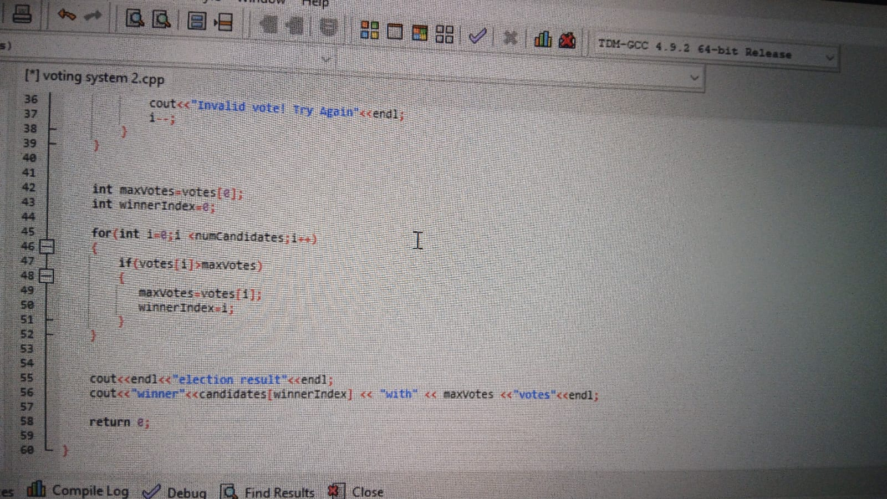

Slide 8
Code Explanation
Input Section:
Number of Candidates: The user enters the number of candidates.
Candidate Names: The program asks for each candidate's name.
Number of Voters: The program also takes input for the number of voters.
Vote Casting:
Voters cast their votes by choosing a candidate (1 to numCandidates).
The program checks whether the vote is valid (within the candidate range).
If not, the voter is asked to vote again.
Vote Tallying:
Votes are tallied in the votes[] array.
The program keeps track of the number of votes each candidate gets.
Winner Calculation:
The program compares the votes and determines the candidate with the highest votes.
Output:
The program prints the election result and announces the winner.

Slide 9
Flow of the Voting System
Step 1:The program starts by asking for the number of candidates.
Step 2: It then asks for the name of each candidate.
Step 3: Next, the number of voters is entered.
Step 4: Voters cast their votes, which are validated.
Step 5: The system counts the votes and determines the winner.
Step 6: The results are displayed with the winner's name and vote count

Slide 10
Example Output
Enter number of candidates: 3
Enter the name of candidates:
Candidate 1: Ali
Candidate 2: Bilal
Candidate 3: Ahmad
Enter number of voters: 5
Voter 1, cast your vote (1 to 3): 1
Voter 2, cast your vote (1 to 3): 2
Voter 3, cast your vote (1 to 3): 1
Voter 4, cast your vote (1 to 3): 3
Voter 5, cast your vote (1 to 3): 1

Slide 11
Output:
Election result:
Winner: Ali with 3 votes.

